Slide 1
CS5551 Advanced Software Engineering Architectural Pattern N-Tier Architecture & MVC: Servlet/Bean/JSP

Slide 2
What are Design Patterns/Architectural Patterns?
Design pattern is a general solution to a commonly-occurring problem
a template for solving a problem that can be used in many different problems or solutions.
Architectural pattern are similar to software design pattern but have a broader scope.
a solution to a commonly occurring problem in software architecture within a given context.
Client-Server Architecture
N-Tier (Multitier) Architecture
MVC Pattern
Multitier architecture (n-tier architecture) is a client–server architecture in which presentation, application processing, and data management functions are physically separated. The most widespread use of multitier architecture is the three-tier architecture.

Slide 3
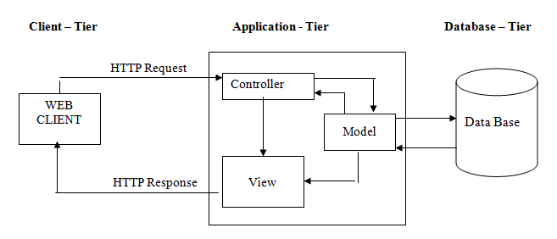
Client-Server Architecture

Slide 4
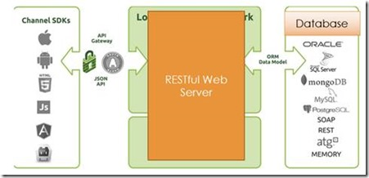
Client-Server Architecture

Slide 5
What is MVC?
Model-View-Controller architecture is used for developing web-applications.
This model is for decoupling between business logic and data presentation to web user.
Thus model divides the web based application into three layers:
Model contains the business logics and functions that manipulate the application data.
View is responsible for presentation aspect of application according to the current state of model data and query response to the controller.
Controller accepts and intercepts user requests and controls the business objects to fulfil these requests.

Slide 6
MVC: Model-View-Controller
Model-View-Controller is made up of
a number of smaller design patterns.
is an aggregate design patterns
So, we call it as architectural pattern.
MVC pattern is basically layered architecture for a Web application.
It evolves from front controller pattern
It is related to the design of web applications. It is "a controller that handles all requests for a Web site", which is a useful structure for web application developers to achieve the flexibility and reuse without code redundancy.

Slide 7
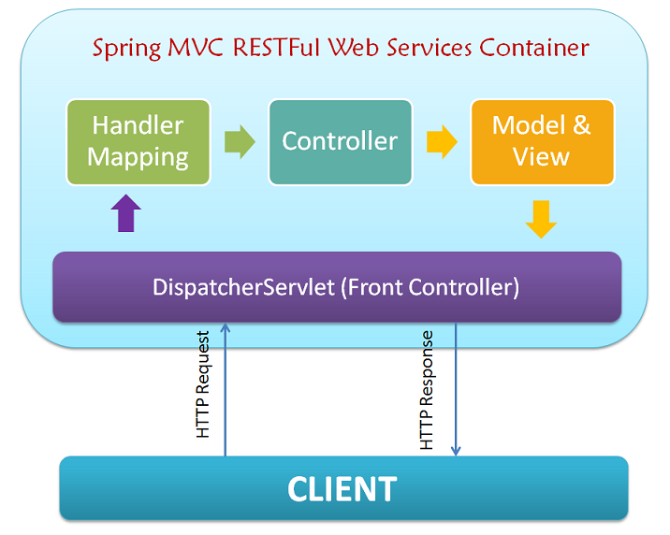
REST Web Services: Web Client & Web Server
MongoDB

Slide 8
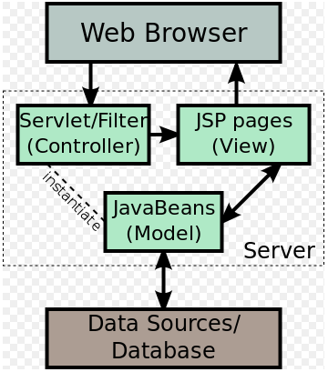
MVC Architecture Pattern
Client
sees
uses
View
Controller
updates
manipulates
Model
http://www.programmingopiethehokie.com/2014_02_01_archive.html

Slide 9
Life of a Servlet
Database
Web
Browser
Web
Server
Java
Servlet

Slide 10
Controller: Servlet
Controller
Designed as a connector between model and View layer, separating one from each other.
Mostly implemented using technologies : Servlet/JSP.
Servlet
A Java program that runs within the web server.
It acts as controller in MVC architectural pattern

Slide 11
A Java Servlet :
Looks like a regular Java program
import java.io.*;
import javax.servlet.*;
import javax.servlet.http.*;
public class HelloWorld extends HttpServlet {
public void doGet(HttpServletRequest req, HttpServletResponse res)
throws ServletException, IOException {
res.setContentType("text/html");
PrintWriter out = res.getWriter();
out.println("<HTML>");
out.println("<HEAD><TITLE>Hello World</TITLE></HEAD>");
out.println("<BODY>");
out.println("<BIG>Hello World</BIG>");
out.println("</BODY></HTML>");
}
}

Slide 12
View Layer: Java Server Pages (JSP)
View Layer
Designed for providing an interface to application for users
It is the channel for getting data in and out of the application
It does not contain any code for
persisting data to or
retrieving data from a data source.
Mostly implemented using technologies
HTML/JSP,XML/XSLT, Velocity, Swing
Java Server Pages (JSP)
Compiled into Java Servlets by JSP compilers
Can be used alone or in conjunction with servlets
Represent (yet) another method for creating server side applications
It also used for presentation layer along with HTML.(as view layer)

Slide 13
A JSP Page :
Looks like a regular HTML page.
<html>
<head>
<title>Hello, World JSP Example</title>
</head>
<body>
<h2> Hello, World!
The current time in milliseconds is
<%= System.currentTimeMillis() %>
</h2>
</body>
</html>
Embedded Java
command to
print current time.

Slide 14
Model Layer: Java Beans
Model Layer
Designed for
capturing logic and
data access code
Model layer is a self contained
Its functions are independent from the view and control layer
Mostly implemented using technologies
Enterprise JavaBeans, Java Data Objects, Data Access Objects
Java Beans
A Java Bean is a reusable software component that can be manipulated visually using a builder tool.
Features that distinguish a Java Bean from Java objects are:
Support for examination, customization, events, properties, persistence

Slide 15
Advantage of MVC
Separation of data from presentation layer
Ability of have multiple view of single data
It is less painful to change a data layer or business rules
Ability to have multiple interface for the same application

Slide 16
What’s MongoDB
Document Oriented Database
Data is stored in documents, not tables / relations
MongoDB stores data in BSON
MongoDB is Implemented in C++ for best performance
Platforms 32/64 bit Windows, Linux, Mac OS-X, FreeBSD, Solaris
Language drivers for:
Ruby / Ruby-on-Rails
Java
C#
JavaScript
C / C++
Erlang Python, Perl others..... and much more ! ..

Slide 17
Terminology
RDBMS | Mongo
Table, View | Collection
Row(s) | JSON Document
Index | Index
Join | Embedded Document
Partition | Shard
Partition Key | Shard Key

Slide 18
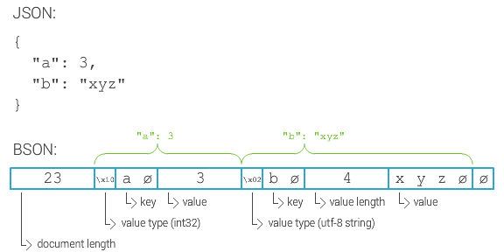
BSON
“Binary JSON”
JSON has powerful, but limited set of datatypes
Mongo extends datypes with Date, Int types, Id, …
MongoDB stores data in BSON
Bsondump: BSON ➔ JSON
BSON is a binary representation of JSON
Optimized for performance and navigational abilities (fast scan ability)
Also compression
See bsonspec.org

Slide 19
Why MongoDB
Intrinsic support for agile development
Super low latency access to your data
Very little CPU overhead
No Additional caching layer required
Built in Replication and Horizontal Scaling support

Slide 20
Use Cases
RDBMS replacement for high-traffic web applications
Content Management-type applications
Real-time analytics
High-speed data logging
Web 2.0, Media, SaaS, Gaming, Finance, Telecom, Healthcare

